Slide 1




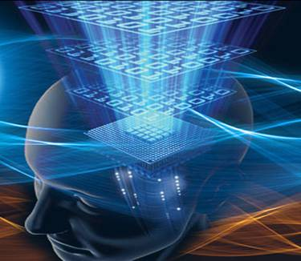
Presented By:
Neha Rathore
C.S.&E. 3rd year
Under the guidance of:
Mr. Abukaf Kasif
N.C.E.T. Kanpur

Slide 2


What is mind reading ?
Why mind reading ?
Technology behind mind reading.
Applications of mind reading.
Examples of mind reading.
Conclusion.
N.C.E.T. Kanpur

Slide 3


N.C.E.T. Kanpur

Slide 4

Mind reading may refer to:
Telepathy, the transfer of information between individuals by means other than the five senses.
It can be referred as “Technological Thought identification”, the use of Neuroimaging techniques to read human minds
A computational model of mind-reading has drawn inspiration from psychology, computer vision and machine learning.
N.C.E.T. Kanpur
Notes:
People express their mental states, including emotions, thoughts, and desires, all the time through facial expressions, vocal nuances and gestures. This is true even when they are interacting with machines. Our mental states shape the decisions that we make, govern how we communicate with others, and affect our performance. The ability to attribute mental states to others from their behavior and to use that knowledge to guide our own actions and predict those of others is known as theory of mind or mind-reading.
Mind reading can be referred as Telepathy, “the transfer of information between individuals by means other than the five senses”
This is the the illusion of telepathy in the performing art of mentalism
It can be referred as Technological Thought identification, the use of Neuroimaging techniques to read human minds

Slide 5

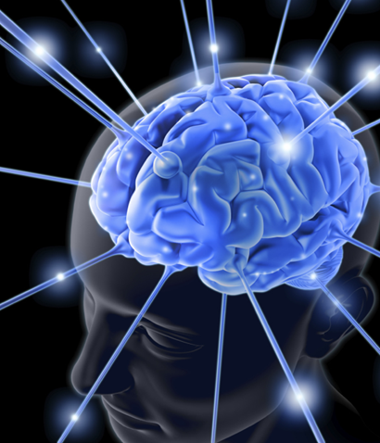
It’s all in the Brain
Perception
Attention
Memory
Language
Emotion
Personality
Decision making
Arts & aesthetics
Moral reasoning
Social interaction
N.C.E.T. Kanpur
Notes:
It’s all in the brain - everything about human behavior, human nature, and human society is controlled by the human brain. Neuroscientists have focused in the past on a handful of basic, core topics (perception, memory, emotion). But we are now beginning new interdisciplinary collaborations to explore, from a neuroscientific point of view, topics that used to be outside the purview of science.
Conjecture: The human mind (perceptions, emotions, memories, thoughts ) can be completely explained by the electrical and chemical activity of the brain. A computer can, in a very real sense, read human minds. The key to this technique is neuroimaging that is used in technology to read the mind. The computer mind-reading technique is far more than a laboratory stunt.
If we could learn to identify brain waves generated by specific thoughts or commands, we might be able to teach the same skill to a computer.
If this conjecture is correct, then it will be possible with neuroscience methods like fMRI to measure any and all aspects of an individual’s mental state (conscious and unconscious). The current techniques for non-invasive measurement of human brain function are limited but both the techniques themselves and our ability to use them effectively will continue to improve as we understand more about brain function.
To understand this, first we will have to understand some basics of the human mind.

Slide 6


N.C.E.T. Kanpur

Slide 7

The mind-reading computer system presents information about your mental state as easily as a keyboard and mouse present text and commands.
N.C.E.T. Kanpur
Notes:
The mind-reading computer system presents information about your mental state as easily as a keyboard and mouse present text and commands.
Imagine a future where we are surrounded with mobile phones, cars and online services that can read our minds and react to our moods.
The technique, discovered by British and German researchers in 2007, allows looking deep inside people’s brains and reading their intentions before they act. The research breaks controversial new ground in scientists’ ability to probe human minds and their thoughts.

Slide 8
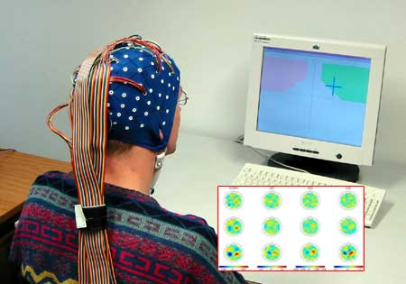
Technology behind mind reading
N.C.E.T. Kanpur

Slide 9
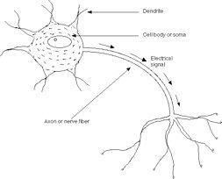
Neurons
The most important and basic part of the brain is NEURON. Neurons are the core components of the nervous system.
Neurons represent and transmit information electrically
N.C.E.T. Kanpur
Notes:
Neurons are the basic building blocks of the nervous system
Neurons represent and transmit information electrically.
Neuron is an electrical excitable cell that processes and transmits information by electrochemical signalling via connection with other cells.
As you can see in the diagram, there are dendrites. Inputs from other neurons arrive here and they can be combined in various ways such as input signals might be added, subtracted or divided by one another.
Result of this computation propagates along the axon to serve as inputs to other neurons. Some axons are very short and some are very long down the spinal cord to innervate a muscle.
Soma is the cell body in between dendrites and axon.

Slide 10
Neuroimaging
Neuroimaging falls into two broad categories:
Structural imaging
Functional imaging
Structural imaging, deals with the structure of the brain and the diagnosis of gross (large scale) intracranial disease (such as tumor), and injury.
2. functional imaging, used to diagnose metabolic diseases and lesions on a finer scale (such as Alzheimer's disease) and also for neurological and cognitive psychology research and building brain-computer interfaces.
N.C.E.T. Kanpur
Notes:
Mind reading technology is basically based on the Neuroimaging.
Neuroimaging includes the use of various techniques to either directly or indirectly image the structure, function/pharmacology of the brain.
Neuroimaging falls into two broad categories:
Structural imaging and functional imaging
Structural imaging, deals with the structure of the brain and the diagnosis of gross (large scale) intracranial disease (such as tumor), and injury.
functional imaging, used to diagnose metabolic diseases and lesions on a finer scale (such as Alzheimer's disease) and also for neurological and cognitive psychology research and building brain-computer interfaces.
Functional imaging enables, for example, the processing of information by centers in the brain to be visualized directly. Such processing causes the involved area of the brain to increase metabolism and "light up" on the scan.
In early 2000s the field of neuroimaging reached the stage where limited practical applications of functional brain imaging have become feasible. The main application area is crude forms of brain-computer interface.
Some important brain imaging techniques that are used are as follows:

Slide 11
Brain Imaging Techniques
Computed Axial Tomography
Diffuse Optical Imaging
Event-Related Optical Signal
TMS (Transcranial Magnetic Stimulation)
Magnetic resonance imaging (MRI)
Functional magnetic resonance imaging(FMRI)
Electroencephalography (EEG)
Magnetoencephalography (MEG)
Positron Emission Tomography (PET)
N.C.E.T. Kanpur

Slide 12
Computed Axial Tomography
Computed Axial Tomography (CAT) scanning uses a series of x-rays of the head taken from many different directions.
Modern CT scanning can provide reasonably good images in a matter of minutes.
N.C.E.T. Kanpur

Slide 13
Diffuse Optical Imaging
Diffuse optical imaging (DOI) is a medical imaging technique which uses infrared light to generate images of the body.
Diffuse optical imaging (DOI) is Diffuse optical imaging (DOI).
N.C.E.T. Kanpur
Notes:
Computed axial tomography
Computed tomography (CT) or Computed Axial Tomography (CAT) scanning uses a series of x-rays of the head taken from many different directions. CT scanning uses a computer program to estimate how much of an x-ray beam is absorbed in a small volume of the brain.
It is typically used for quickly viewing brain injuries.
CT scans are primarily used for evaluating swelling from tissue damage in the brain
In today's time, CT scanning can provide very good images in few minutes.
Diffuse optical imaging (DOI) or diffuse optical tomography (DOT) is a medical imaging technique which uses infrared light to generate images of the body.
The technique measures the optical absorption of hemoglobin

Slide 14
Event-Related Optical Signal
Event-related optical signEROS al (EROS) is a brain-scanning technique which uses infrared light through optical fibers.
Can pinpoint activity in the brain within millimeters and within milliseconds.
N.C.E.T. Kanpur
Notes:
Event-related optical signal (EROS) is a brain-scanning technique which uses infrared light through optical fibers.
Its biggest downside is the inability to detect activity more than a few centimeters deep.
EROS is a new, relatively inexpensive technique

Slide 15
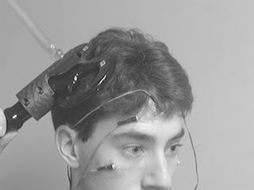
TMS (Transcranial Magnetic Stimulation)
(TMS) is the use of powerful rapidly changing magnetic fields to induce electric fields in the brain by electromagnetic induction without the need for surgery or external electrodes.
N.C.E.T. Kanpur

Slide 16
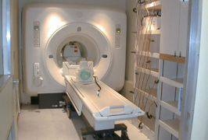
Magnetic Resonance Imaging
Magnetic resonance imaging (MRI) is a medical imaging technique used in radiology to visualize detailed internal structures.
The first MR image was published in 1973.
N.C.E.T. Kanpur

Slide 17
Functional Magnetic Resonance Imaging
FMRI can be used to reveal brain structures and processes associated with perception, thought and action.
FMRI measures oxygen usage throughout the brain.
FMRI is increasingly used for the medical diagnosis of disease.
N.C.E.T. Kanpur
Notes:
Event-related optical signal (EROS) is a brain-scanning technique which uses infrared light through optical fibers.
Its biggest downside is the inability to detect activity more than a few centimeters deep.
EROS is a new, relatively inexpensive technique

Slide 18
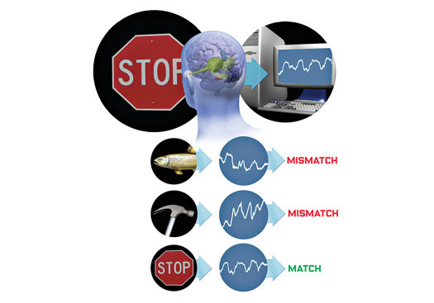
N.C.E.T. Kanpur

Slide 19
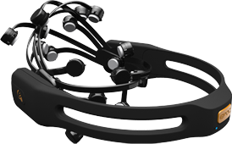
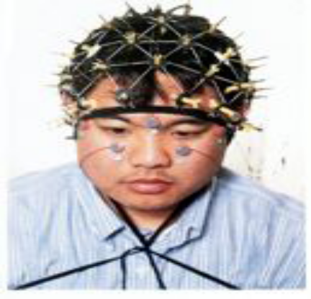
Electroencephalography (EEG)
EEG is an imaging technique used to measure the electric fields in the brain via electrodes placed on the scalp of a human.
EEG, you get millisecond time resolution which is good.
N.C.E.T. Kanpur

Slide 20
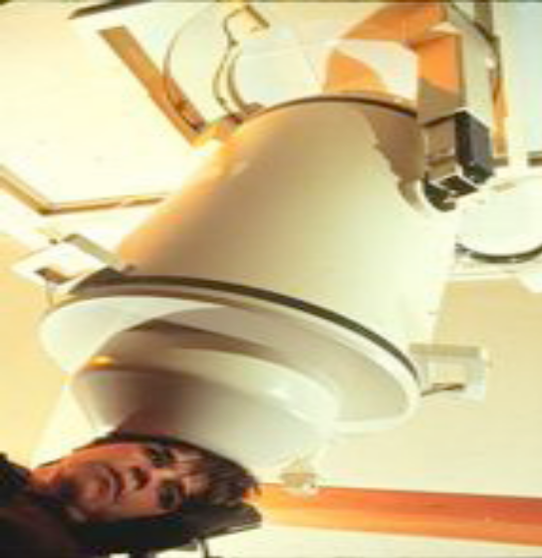
Magnetoencephalography (MEG)
MEG is an imaging technique used to measure the magnetic fields produced by electrical activity in the brain.
N.C.E.T. Kanpur

Slide 21
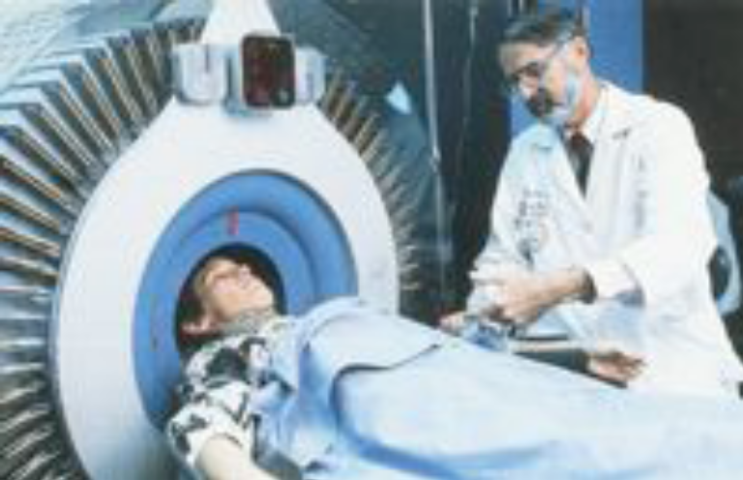
Positron Emission Tomography (PET)
Both FMRI and PET depend on regional control of blood flow in the brain. But, current FMRI methods go way beyond the conventional PET
N.C.E.T. Kanpur

Slide 22

N.C.E.T. Kanpur

Slide 23
Applications
Applications of mind reading technology is almost in every field.
Medical field, sports, video gaming are few to be named
Designers and technology experts claim that possibility is not impossible and is not limited to, whether it's for relaxation, brain training, entertainment, games, social networking, sports, or sleep.
N.C.E.T. Kanpur

Slide 24

N.C.E.T. Kanpur

Slide 25
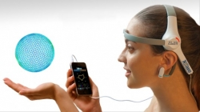
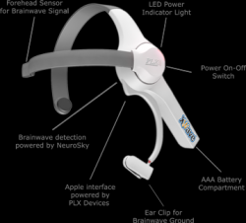
Mind-Reading iPhone: XWave
XWave is the first technology product that cost under $ 100 that can sense and detect the human brain waves, interpreting the mind and connecting with everyday technology.
Original Technology is invented by NASA.
Brainwave detection and research has been on trial. .
The XWave permits the user to control objects displayed on computer screens.
N.C.E.T. Kanpur

Slide 26
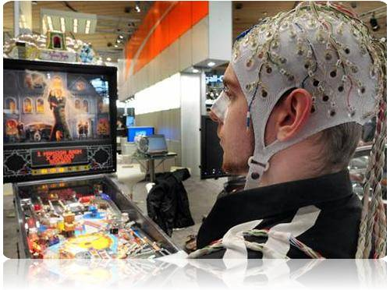
Intel’s Mind-Reading Brain-Scan Technology
In 2010, Intel Corporation showed the software that uses brain scans to determine what items people are thinking about.
In tests, it guessed with 90 percent accuracy which of two words a person was thinking about.
N.C.E.T. Kanpur

Slide 27

LIE DETECTORS
Lie detection is the practice of determining whether someone is lying.
Studies using fMRI have shown that it has potential to be used as a method of lie detection.
Now scientists are developing a lie detector that can tell if someone is telling the truth by monitoring the movement of their eyes.
N.C.E.T. Kanpur

Slide 28

N.C.E.T. Kanpur

Slide 29
Conclusion
Mind reading technology is growing very fast and in future it can be used in many more applications that will be beneficial for the human beings.
There are some issues that can be raised related to this technology.
It must be ensured that this technology should not be misused otherwise it can be very harmful
N.C.E.T. Kanpur

Slide 30


N.C.E.T. Kanpur

Slide 31

N.C.E.T. Kanpur

